Slide 1
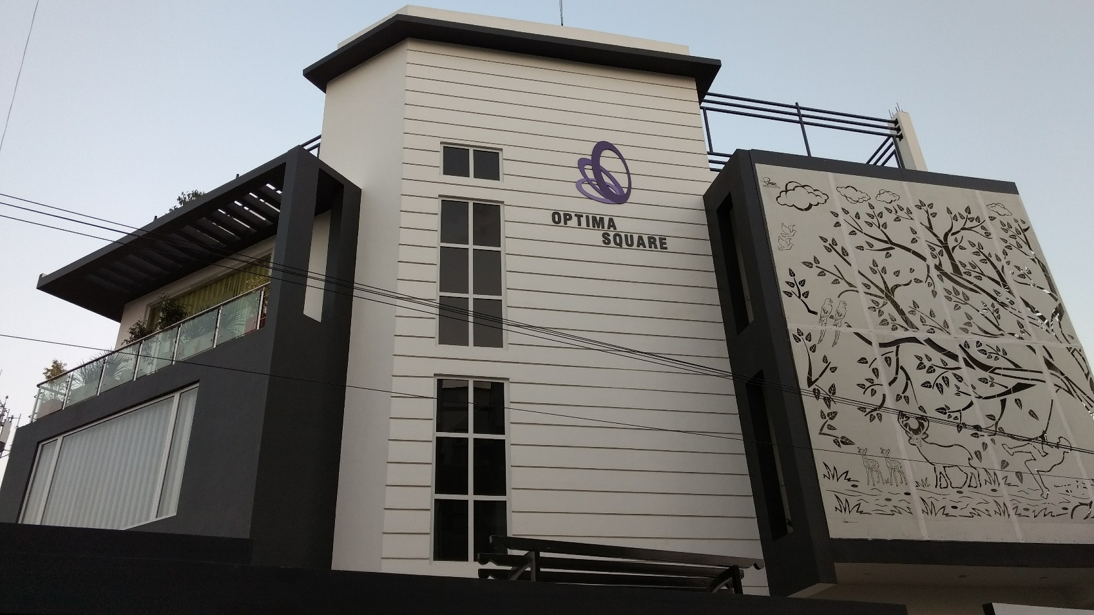
OPTIMA POULTRY PVT LTD
WELCOME YOU ALL

Slide 2
OPTIMA POULTRY PRIVATE LIMITED
A private limited company registered under the Indian Companies Act, 1956 and are manufacturers & dealers in livestock and poultry feed supplements and equipment's for clients around the nation. The company also engaging in Research & Development activities related to veterinary industry.
Started on 2011 at Pune, Maharashtra, the company extended its activities in southern states having office in Coimbatore.
Directors Dr. K.R.Gunaseharan, Mrs. G.Hemaapriyaa,
Dr.R.Praburam shankar
Plant - SIDCO Industrial Estate, Coimbatore

Slide 3
MAJOR BRANDS are
Betameth
Ligosa
Rectifier
Clean & Clear

Slide 4
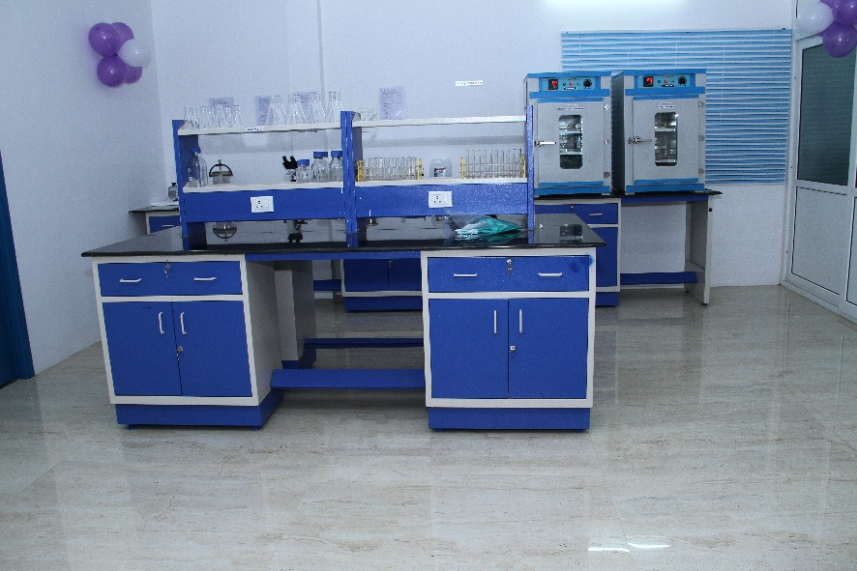
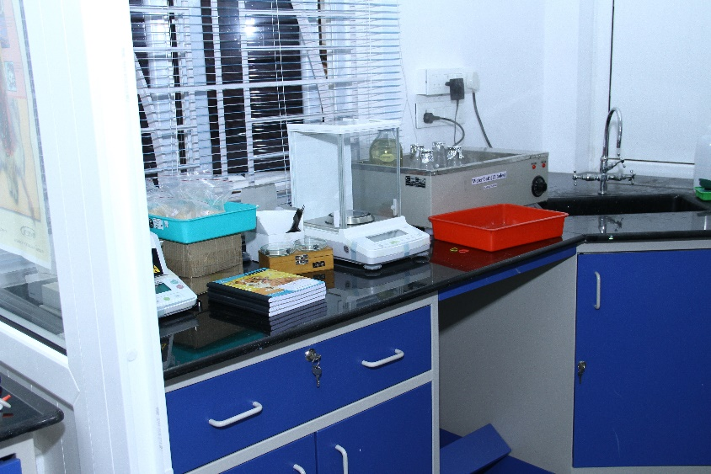
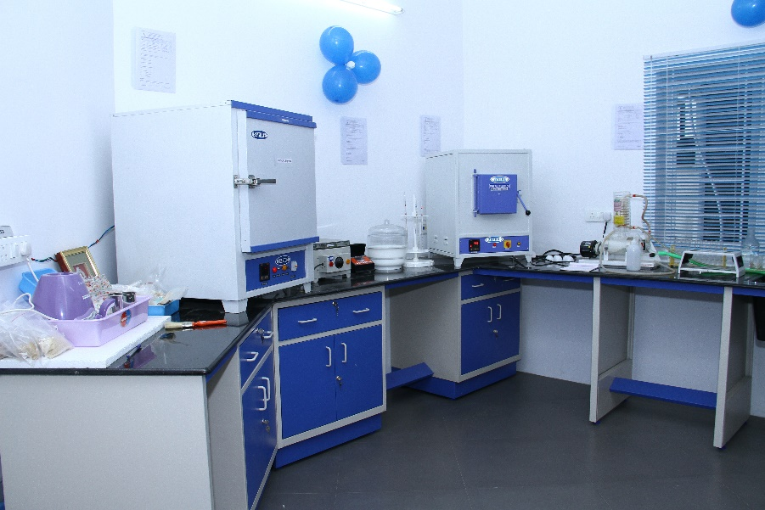
OPTIMA POULTRY PRIVATE LIMITED QUALITY CONTROL LABORATORY

Slide 5
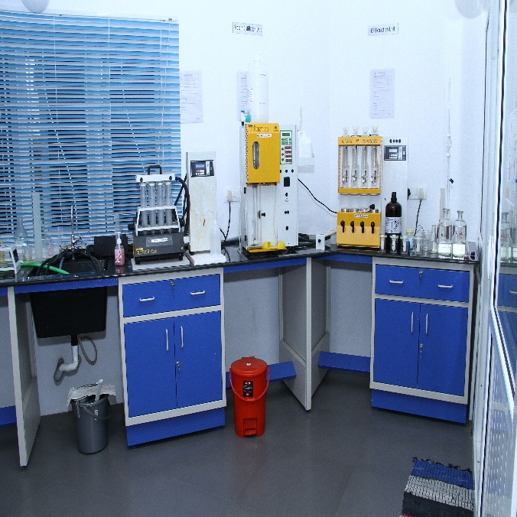

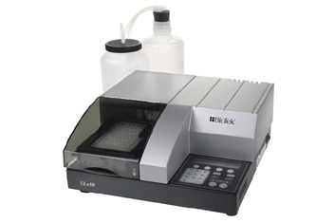
OPTIMA LIFE SCIENCES PRIVATE LIMITED QUALITY CONTROL LAB
Optima Life Sciences having Microbiological & Chemical laboratory in Coimbatore.
It is operated with highly classified equipment's & techniques.
We also doing ELISA and all Proximate Analysis for improving our business

Slide 6

ntjpapay] gFg]gha]t[
jPtdk] kw]Wk] \yg]bghUl]fs]
<ug]gjk] (Mositure)
g[ujr]rj]J (Crude protein)
fiuaf]Toag[ujk] (digestibility protein)
brwpf]fg]gl]l g[ujk] (soluble protein)
tputf]Toa g[ujk]
bgg]rpd] g[ujk] (pepsin Digestibility)
ehh]r]rj]J (Crude Fibre)
bfhGg]g[r]rj]J (Crude oil/fat)
bkhj]j rhk]gy] rj]J kw]Wk] kzy] (Total ash & Sand Silica)
fhy]rpak] (Calcium)
gh!]gu!] (phosphorous)
cg]g[r]rj]J(salt)
jdpj]j bfhGg]g[ mkpyk]
bguhf]irL kjpg]g[[ (peroxide value)
mnahod] kjpg]g[(Iodine value)
g[ujk] my]yhj iel]u$d] [ (Non protein nitrogen)
njhy] czt[ nrhjid
(decomposition and leather meal test)

Slide 7
vjph]g]g[ Cl]lr]rj]J fhuzpfs;
cl]g[u er]Rf]fs]
nrhahtpy] cs]s a{hpV!] bray]ghL
g{r]rpf]bfhy]yp nrhjid
kf]fhnrhsj]jpy] cs]s ijuk] ( nrhjid
fLF g[z]zhf]fpy] cs]s lhf]rpd]
cldo nrhjidfs]
nrhahtpy] cs]s a{hpna!] bray]ghL (urease enzyme activity)
a{hpah nrhjid
njhy] czt[ nrhjid(decomposition and leather meal test)
rpijt[Wjy] nrhjid
fLF g[z]zhf]F nrhjid
,Yg]ig g[z]zhf]F nrhjid
vz]bza]apy] Crpg]nghjy] nrhjid

Slide 8
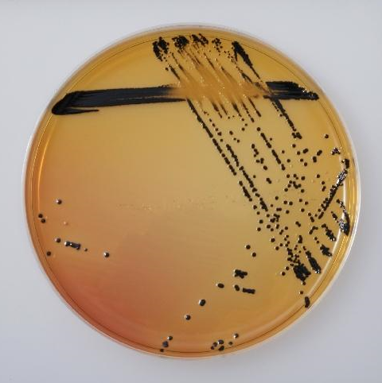
E}z]qaphpay] ghpnrhjidfs]
jPtdk] kw]Wk] jPtd \yg]bghUl]fs]
Differential Count
Total viable count (TVC)
Total Coliforms
Total Yeast and mould (Fungus)
Total Clostridia

Slide 9
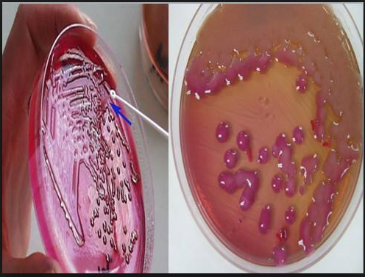
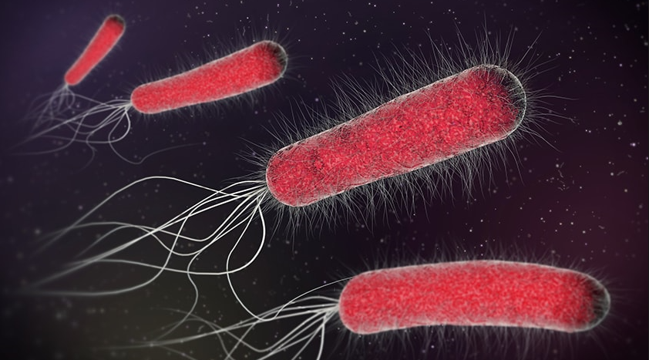
SPECIFIC PATHOGENS
E-coli
Salmonella spp
Shigella spp
Pseudomonas aeruginosa
Enterobacteriaceae
Streptococcus spp
Staphylococcus aureus
Vibrio spp
And other group of GRAM positive and GRAM negative bacteria
Preparation and examination of smears by faeces & urine samples
Antibiotic sensitivity test (ABST)

Slide 10
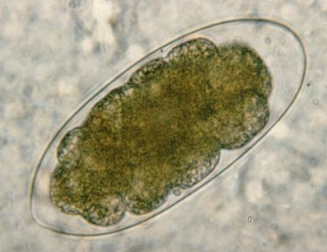
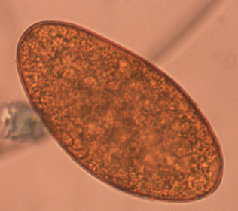
PARASITOLOGY
Camelid worm egg count by faeces
Comprehensive parasitology
Giardia analysis in faeces
Liver fluke egg on individual animals in faeces
Longworm larvae examination in faeces
Worm and fluke egg examination in faeces
Worm make / coccidial oocyst count in faeces
Wormscan bulk worm egg count in faeces

Slide 11

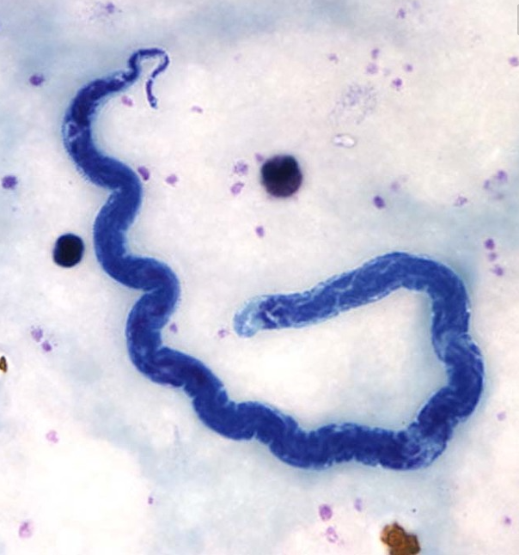
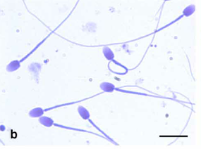
HAEMATOLOGY
Examination for blood parasites
Porcine salmonella in serum samples Enteritis
Adult ruminant enteritis – salmonella, microscopic examination in faeces
E.coli, cryptosporidia, salmonella in faeces
MASTITIS
Mastitis in all species (bacteriology, sensitivity) in milk samples
Bovine respiratory disease as bacteriology, sensitivity
FERTILITY EXAMINATION
Bacteriology of semen and sensitivity
Examination of stained semen slides
Spermatozoa density in semen

Slide 12
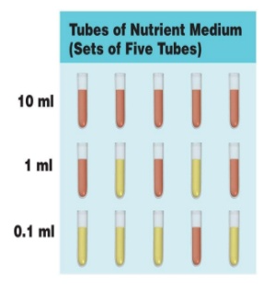
ePh] ghpnrhjidfs]
Water coliforms by MPN
Other bacteria contamination
pH
Total Dissolved Solids (TDS)
Total Hardness (T.H)

Slide 13
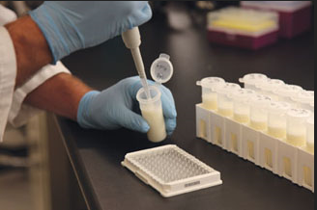

ghy] ghpnrhjidfs]
Traditional raw milk quality test includes:
Standard Plate count (SPC)
Psychrotrophic Bacteria Count (PBC)
Coliform Count (CC)
Resazurin test
Laboratory Pasteurization Count (LPC)
Preliminary Incubation Count (PIC)
Somatic Cell Count (SCC)
pH
Colour
Acidity test
The Lactometer test
Quality Control of Pasteurised Milk

Slide 14
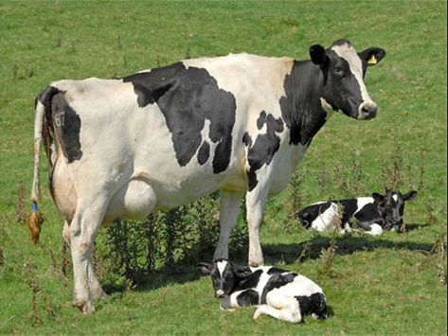
fhy]eil fh]g]ghpnrhjid
Bovine pregnancy glycoprotein (bPAG)
c']fSila khLfis fUt{l]ly] bra]j gpwF 28-30 ehl]fSf]Fs] fh]g]ghpnrhjid bra]ayhk].

Slide 15

Name : Mr.B.NIWAS Designation : Manager Department : Quality Control Mobile : 9047774109 Email : niwas@optimapoultry.in | Name : Mrs. ABIRAMI Designation : Assistant Manager Department : Quality Control Mobile : 9047773384 Email : abirami@optimapoultry.in

Slide 16
Thank You.

